Slide 1
Cybersafety & Indigenous Australians ~Ujjwal Savaliya

Slide 2
What is Cybersafety?
Cybersafety is the safe and responsible use of Information and Communication Technologies (ICT). NetSafe's approach to cybersafety is founded on:
Maintaining a positive approach about the many benefits brought by technologies
Encouraging the public to identify the risks associated with ICT
Putting in place strategies to minimise and manage risks
Recognising the importance of effective teaching and learning programmes.

Slide 3
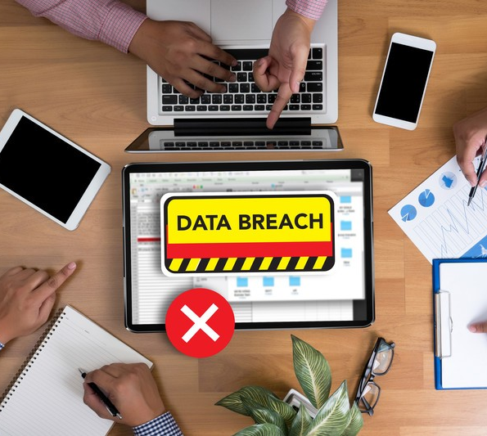
Major Importance of Cybersafety
Communicate data breaches
Appoint a data protection officer
Require user consent to process information
Anonymize data for privacy

Slide 4
1. The distributed nature of the Internet 2. The ability for cybercriminals to attack targets outside their jurisdiction makes policing extremely difficult 3. Increasing profitability and ease of commerce on the dark web 4. The proliferation of mobile devices and the Internet of Things.
Why is Cybercrime Increasing?

Slide 5
What is the Impact of Cybercrime?
Economic Costs
‍Theft of intellectual property, corporate information, disruption in trading and the cost of repairing damaged systems
Reputational Cost
‍Loss of consumer trust, loss of current and future customers to competitors and poor media coverage
Regulatory Costs
‍GDPR and other data breach laws mean that your organization could suffer from regulatory fines or sanctions as a result of cybercrimes.

Slide 6
How cybersafety is impacting Australians
The number of state and cyber criminals with capability will increase.
Due to the limited number of quality software developers, cybercrime-as-a-service is likely to increase, reducing the barriers for entry for cybercriminals.
The sophistication of the current cyber adversaries will increase, making detection and response more difficult.
Spear phishing will continue to be popular with adversaries, and the use of watering-hole techniques will increase.
Ransomware will continue to be prominent.

Slide 7
The Australian Threat Conclusion
Australian government and businesses increasingly rely on the internet to deliver products and services.
This comes with risks – Australian networks and their users are vulnerable to malicious cyber activity such as cyber espionage, cyber attack and cybercrime.
Australia’s information and communications technology (ICT) security community, academia and decision makers in government and business need to:
keep pace with developments.
identify new vulnerabilities.
advise Australian organisations on how to mitigate emerging threats.

Slide 8
References
1. http://www.cybersafety.org.nz/kit/welcome/cybersafety.html

